Slide 1
Tópicos Especiais em Telecomunicações IV: Tecnologias de Acesso e Soluções Emergentes para Redes 5G e Além
Aula 8: Estimação de canal em sistemas massive MIMO
Prof. Dr. João Crisóstomo Weyl Albuquerque Costa (jweyl@ufpa.br)
André Lucas Pinho Fernandes (andrelpf@ufpa.br)
Daynara Dias Souza (daynara@ufpa.br)

Slide 2
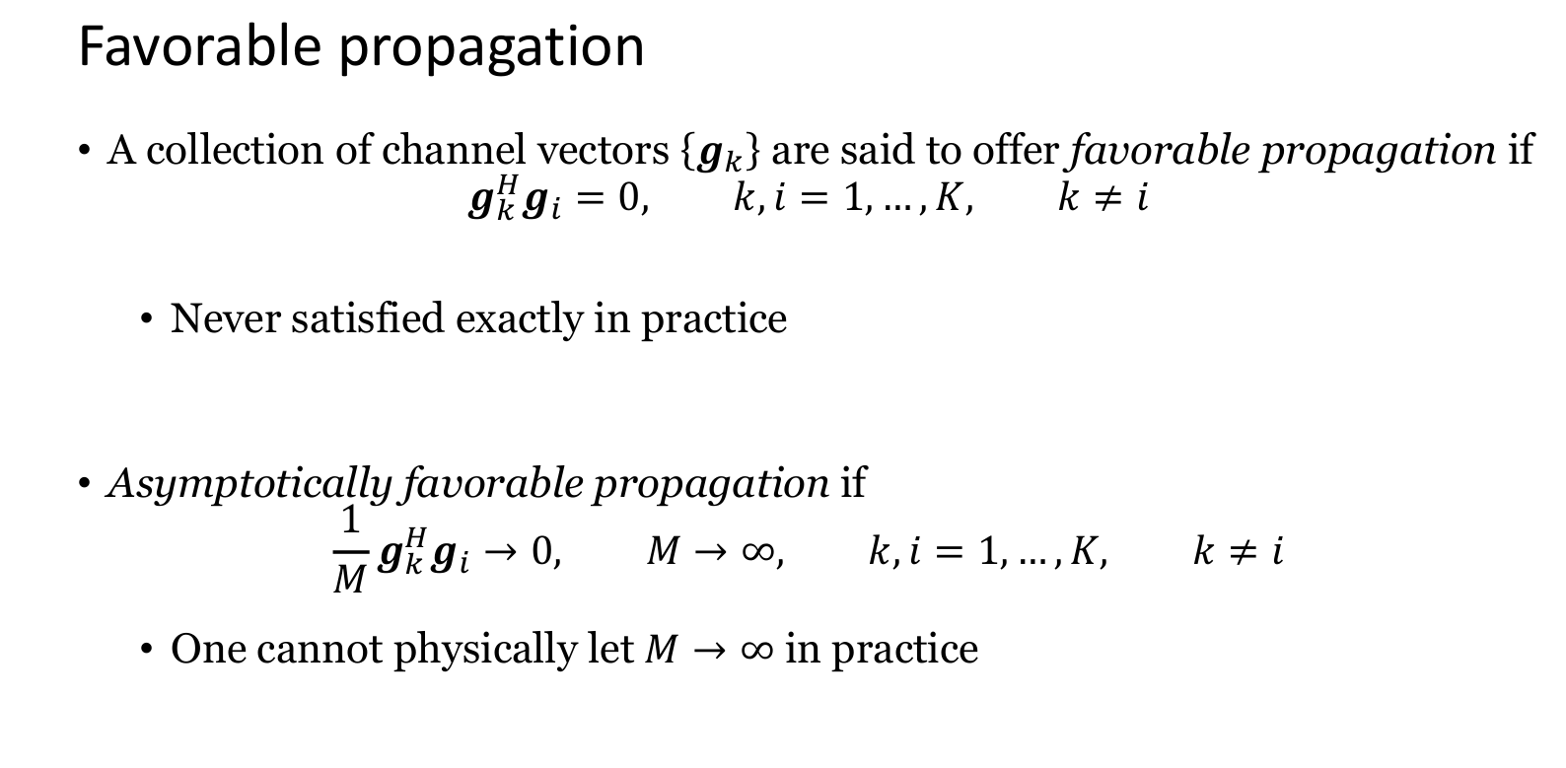

Slide 3
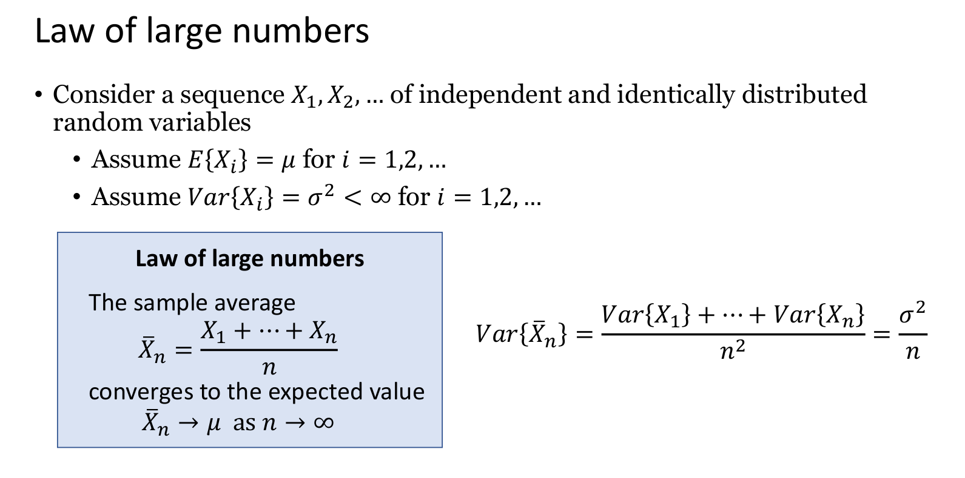

Slide 4
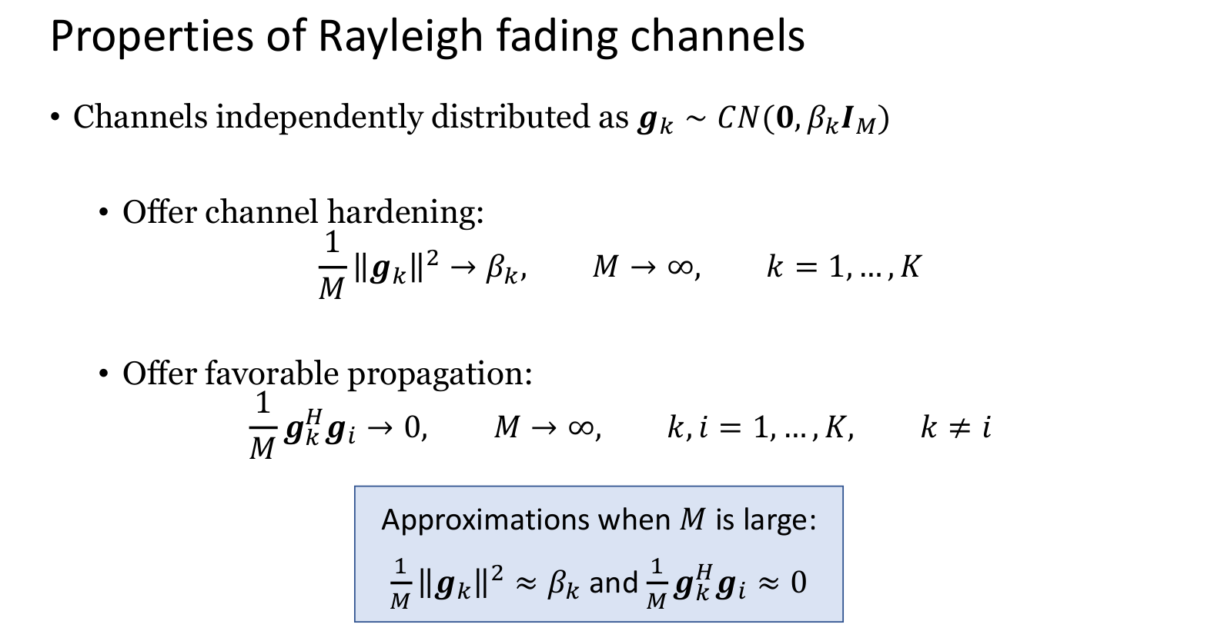

Slide 5
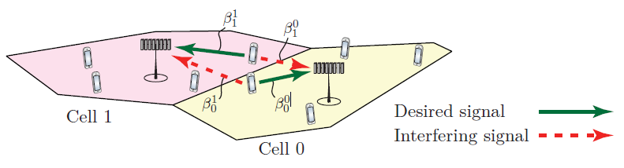
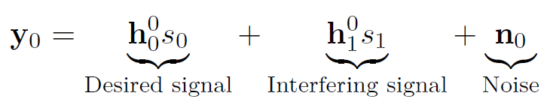
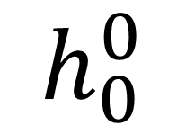
How to model these networks?
Wyner Model – What is? How to use that?
Path Losses
BS that receive the signal
Cell where the user is transmitting

Slide 6

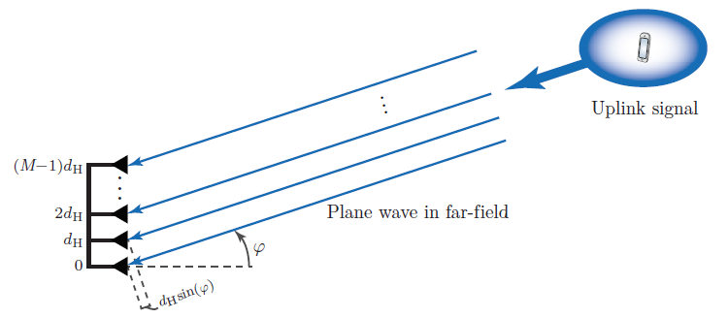

Models for LOS and NLOS
LOS
NLOS
Small scale fading: Shor-term CSI, or uncorrelated Rayleigh Fading

Slide 7
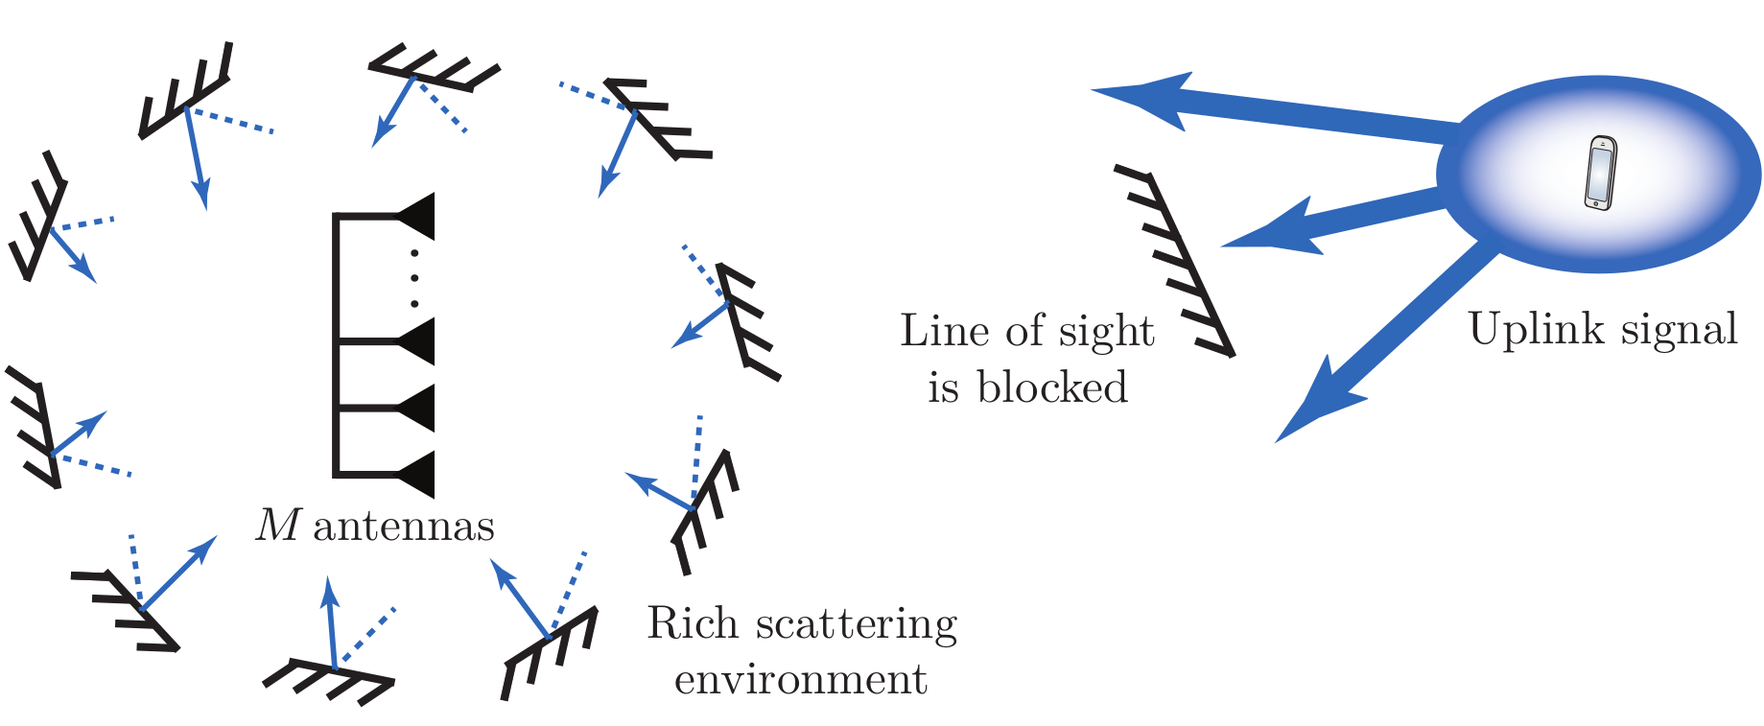
Uncorrelated Rayleigh fading
R = βI_{M} -> diagonal matrix for uncorrelated

Slide 8
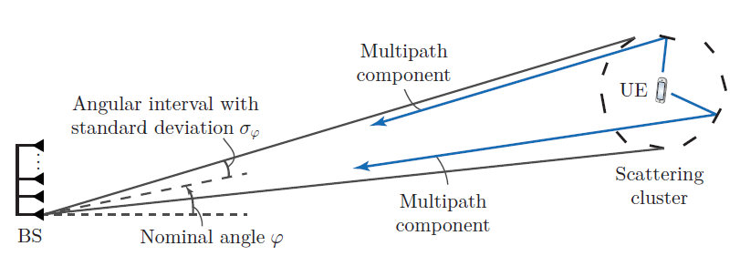
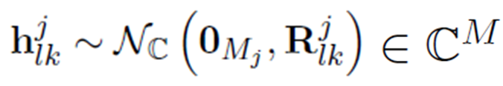

Correlation Matrix
Correlated Rayleigh Fading

Slide 9




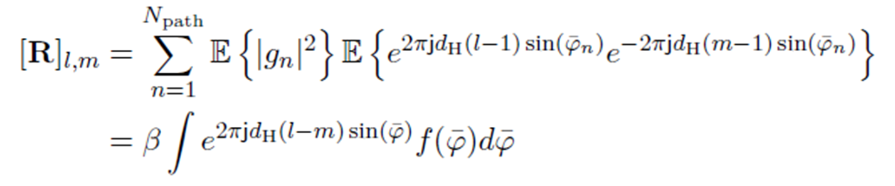
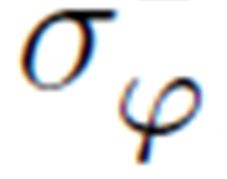
Local scattering model
Correlated Rayleigh Fading
Angular Standard Deviation (ASD)

Slide 10

How to generate a correlated Rayleigh Fading channels?

Slide 11
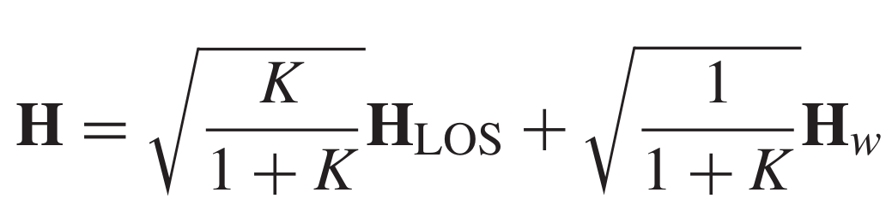
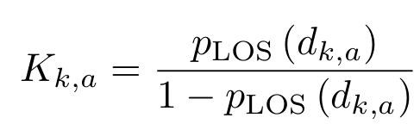
Rician fading?
The Ricean K factor is defined as the ratio of power in the LOS component to the total power in the diffused non line-of-sight (NLOS) component.
The Rician factor between UE k and AP l is given as K _{kl} [dB] = 13−0.03d _{kl}, where d _{kl} is the distance between them in meters.
Or it can be calculated from the LOS probability at Table 7.4.2-1 of 3GPP TR 38.901:

Slide 12
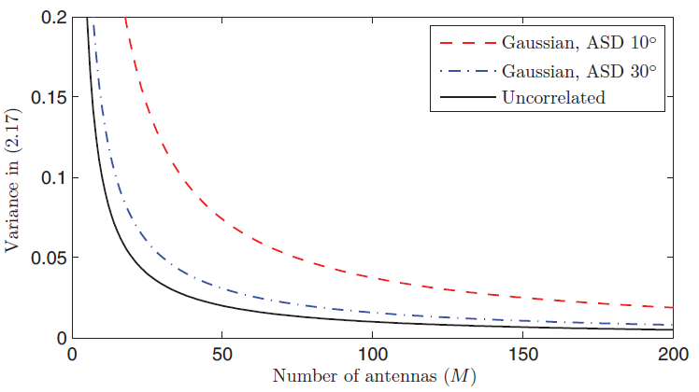
Some impacts of the correlation matrix on channel hardening

Slide 13
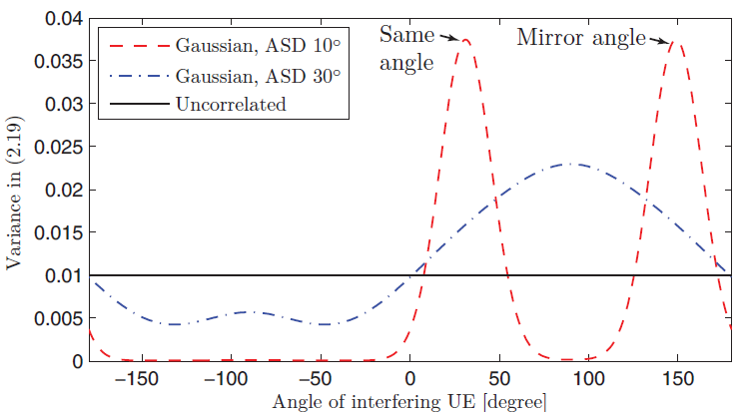
Some impacts of the correlation on favorable propagation

Slide 14
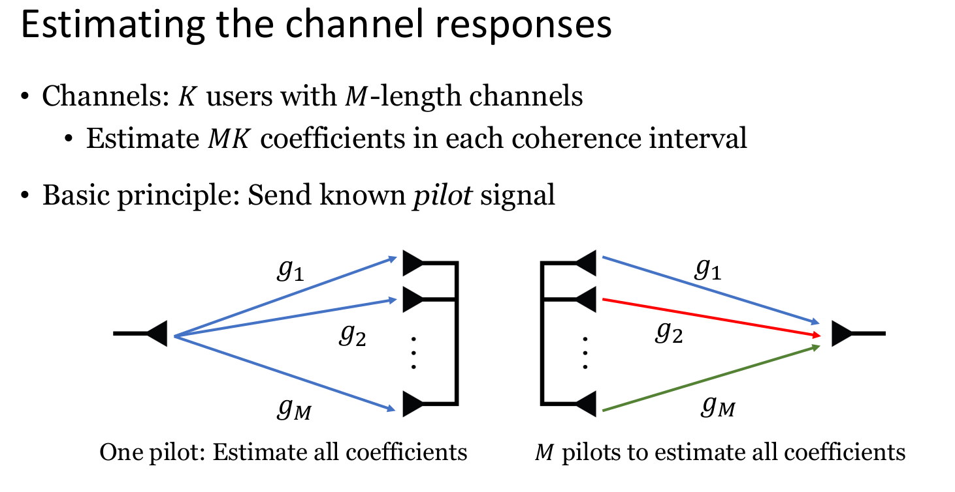

Slide 15
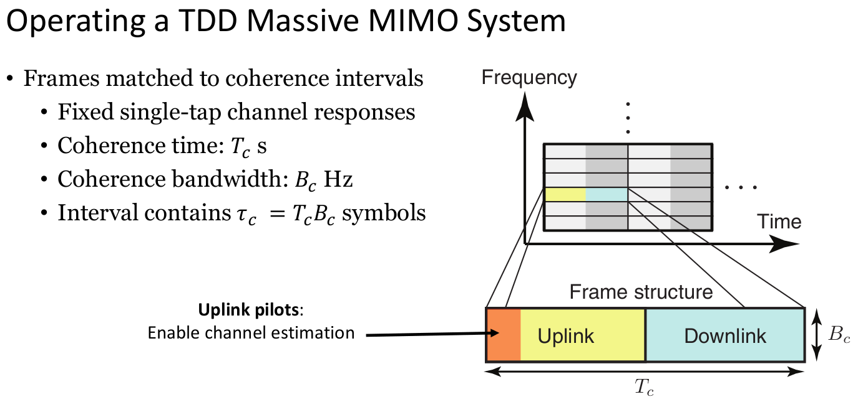

Slide 16
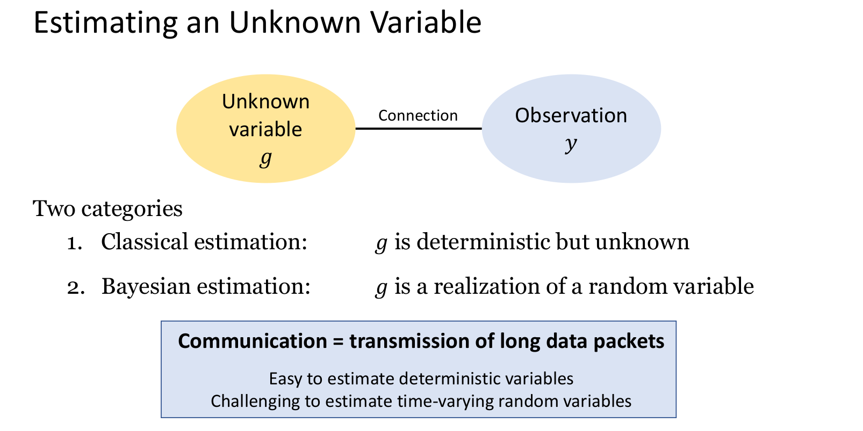

Slide 17
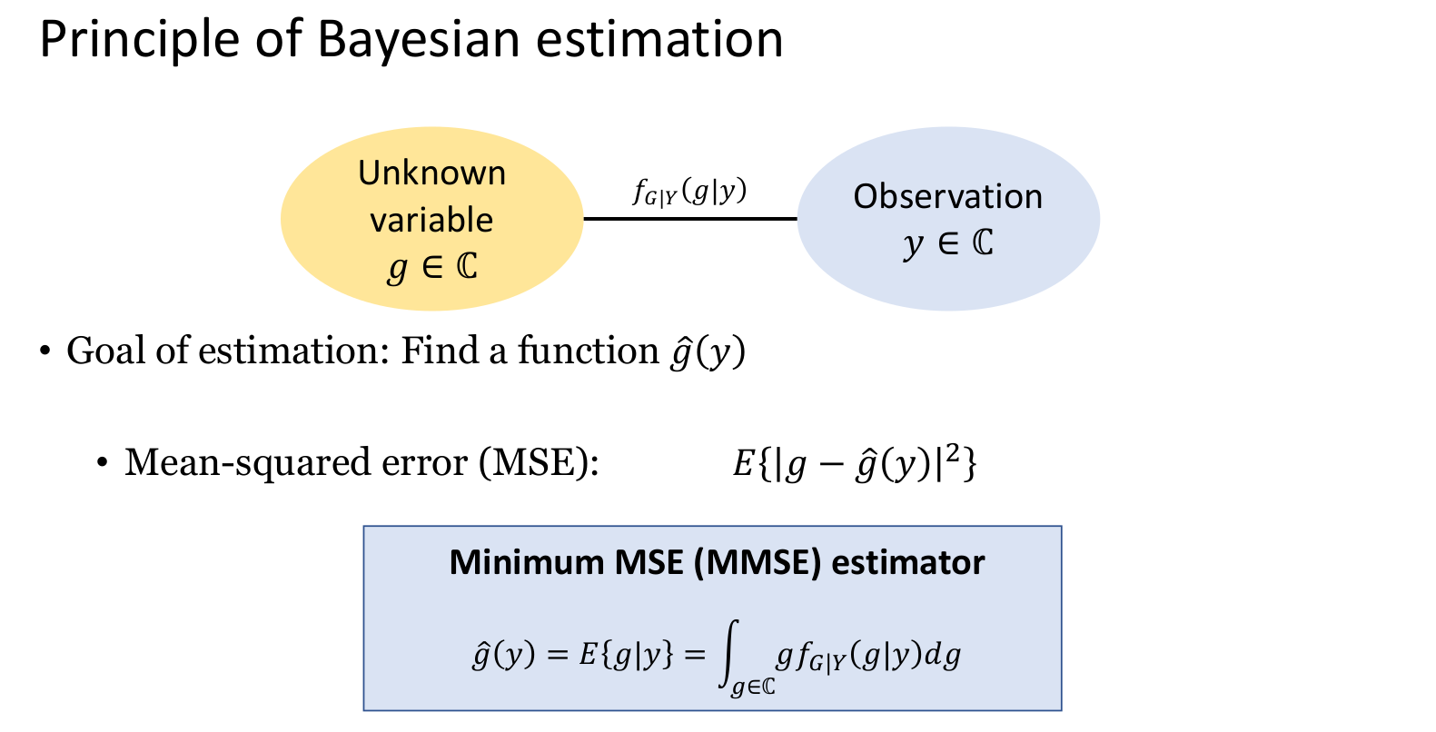

Slide 18
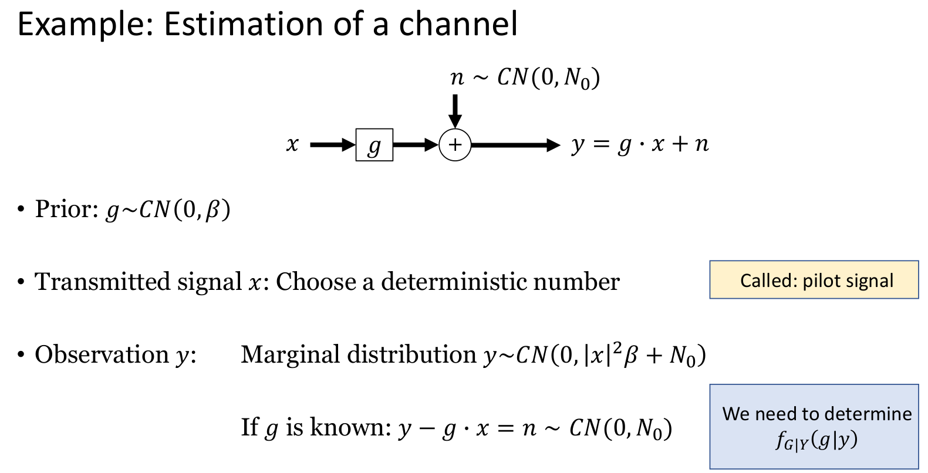

Slide 19
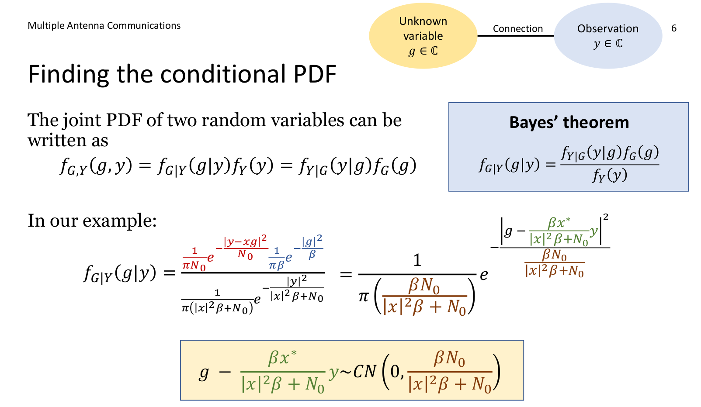

Slide 20
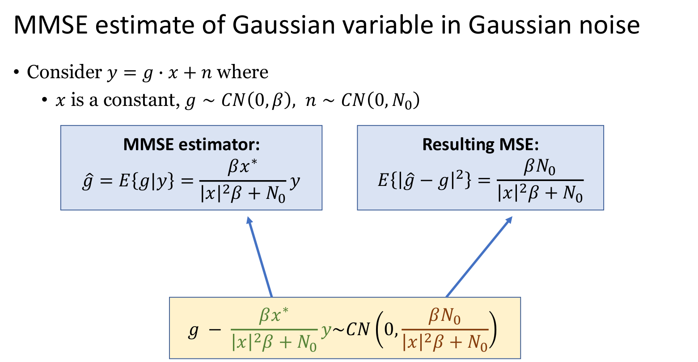

Slide 21
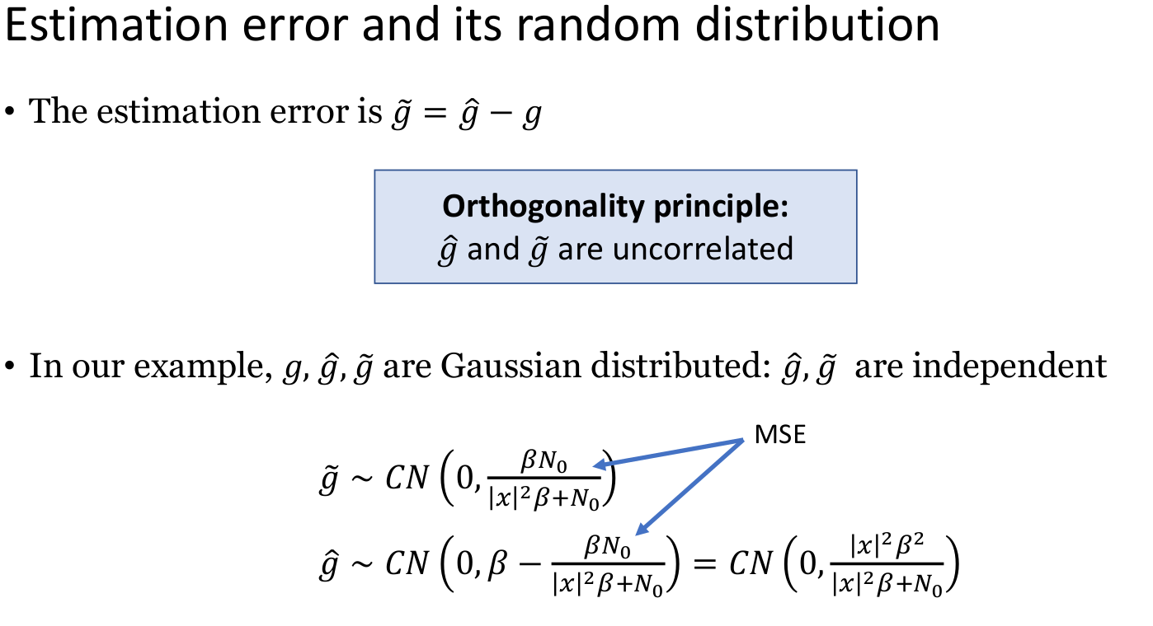

Slide 22
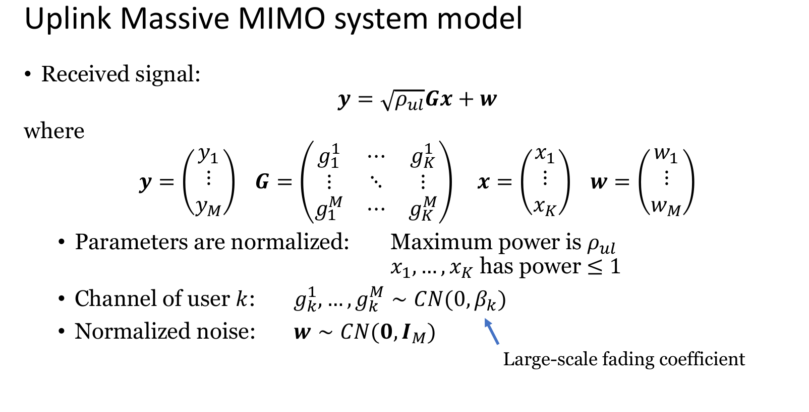

Slide 23
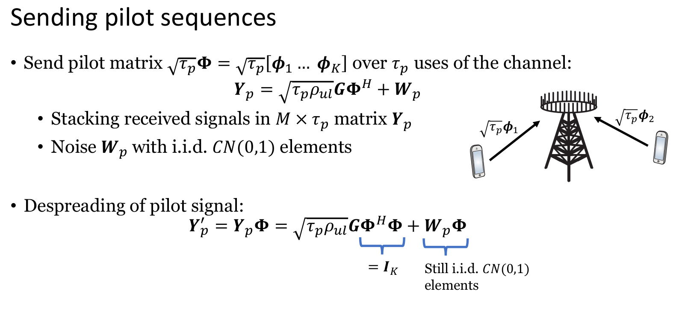

Slide 24
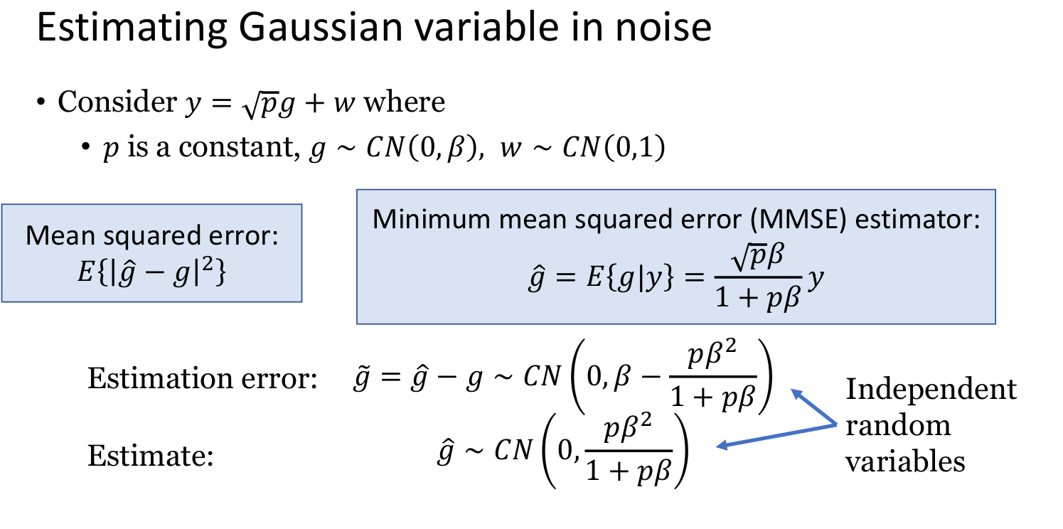

Slide 25
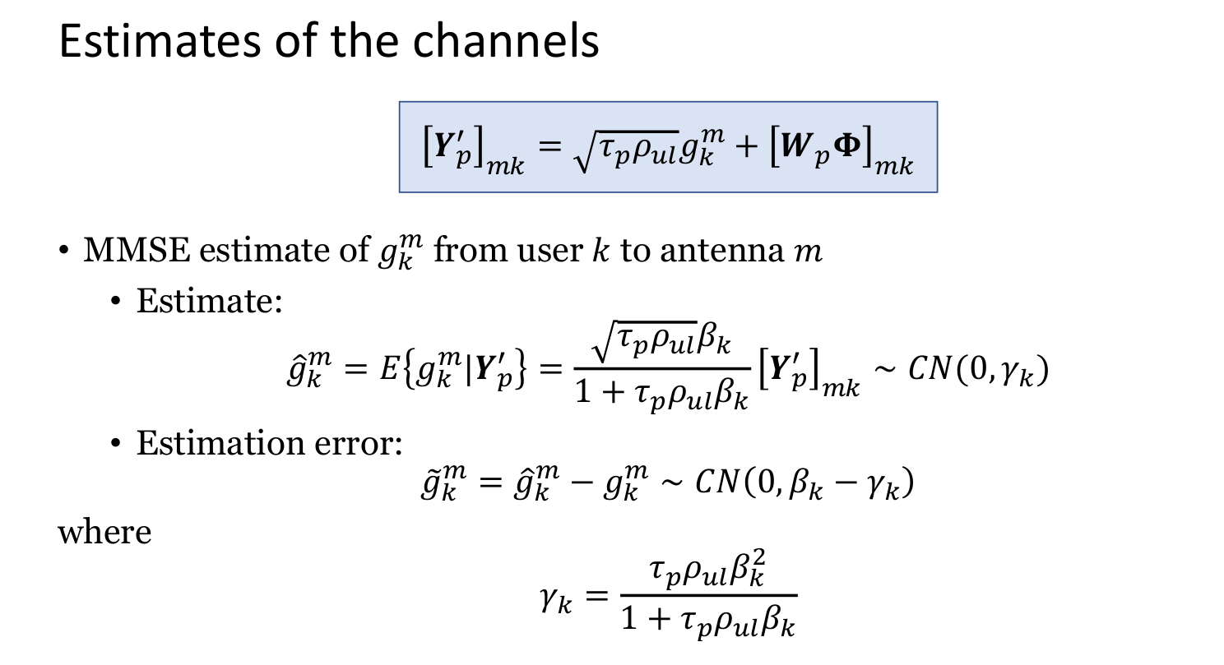

Slide 26
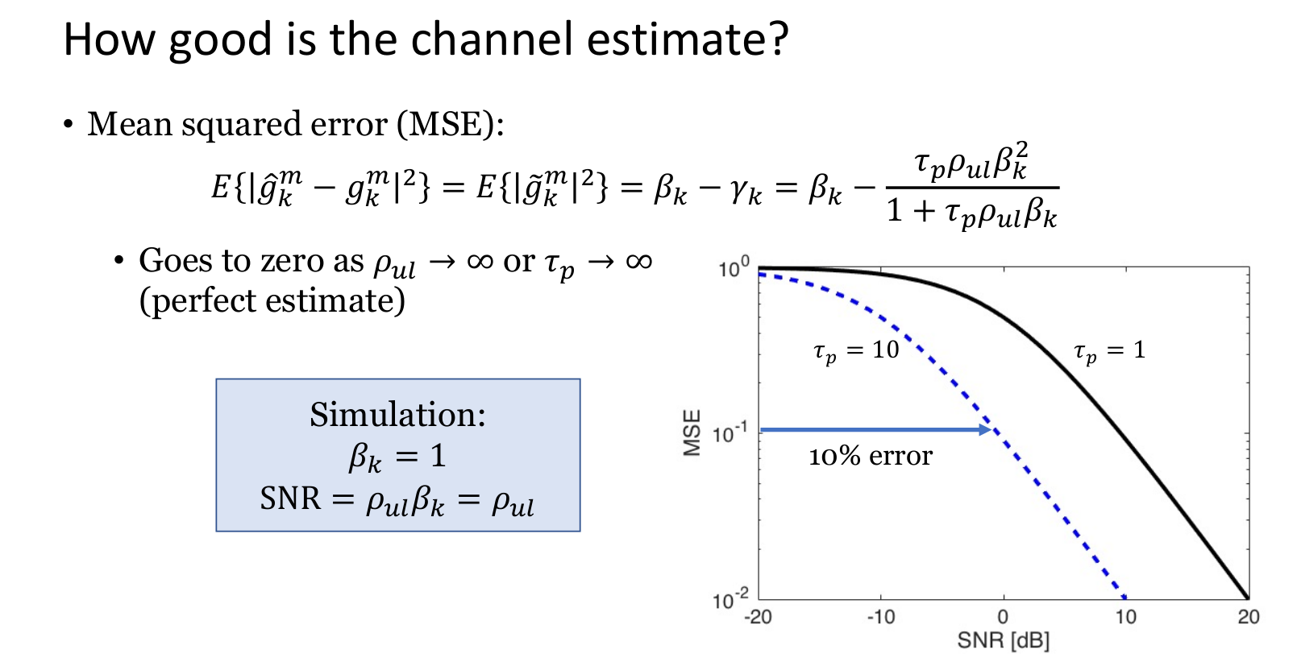

Slide 27
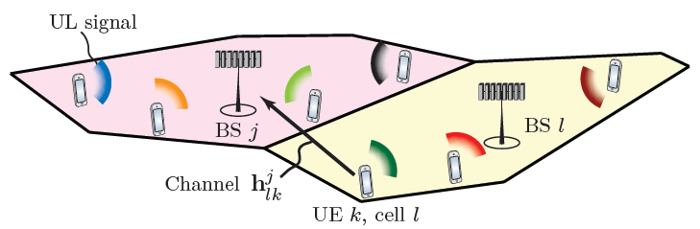

Multicell System model
receiver BS
Incoming cell and transmitting user

Slide 28
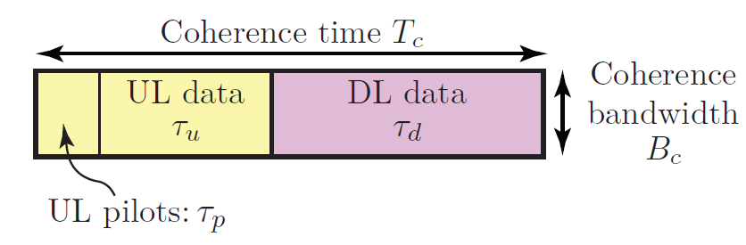


Channel estimation
Each BS needs to estimate the channel responses from the UEs that are active in the current coherence block. It is particularly important for BS j to have estimates of the channels from the UEs in cell j. Channel estimates from interfering UEs in other cells can also be useful to perform interference suppression during data transmission
Remember that τp samples are reserved for UL pilot signaling in each coherence block. Each UE transmits a pilot sequence that spans these τp samples. The pilot sequence of UE k in cell j is denoted by . It is assumed to have unit-magnitude elements to obtain a constant power level and this implies that

Slide 29
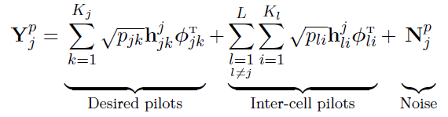






Channel estimation
The elements of scaled by the UL transmit power as , leading to the received UL signal at the base station j. This signal is denoted by and is given by
where is the independent additive receiver noise with i.i.d. elements distributed as complex normal gaussian . If the BS j wants to estimate the channel from an arbitrary UE i in cell l
Same dimension as . Thus

Slide 30


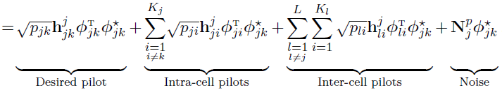
Channel estimation
For the kth UE in the BS’s own cell, the received signal can be expressed as
Ideally, it is desired that the BS’s of the network can allocate different orthogonal pilot sequences for each user. However, the finite length of the coherence block imposes the constraint τp < τc . Consequently, it is not trivial to define it τp . However a rule-of-thumb affirms that τp < τc/2

Slide 31




Channel estimation
Considering the pilot reuse, how to estimate the channels?
First, we assume that each BS of the network utilizes a set of τp orthogonal pilot sequences
Second, it is assumed that . They are gathered as the columns of the UL book pilot
which satisfies
The coordination of the pilot-reuse is done as follows
Hence, implies that UE i in cell l uses the same pilot as UE k in cell j. Note that
by definition

Slide 32
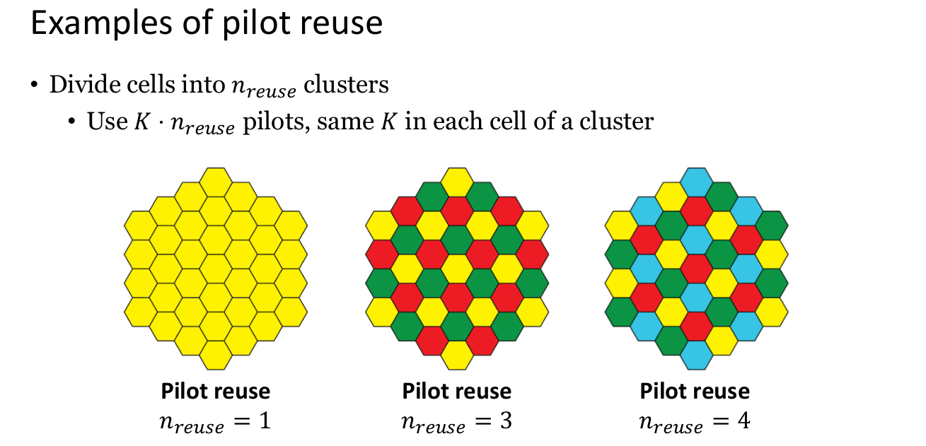

Slide 33
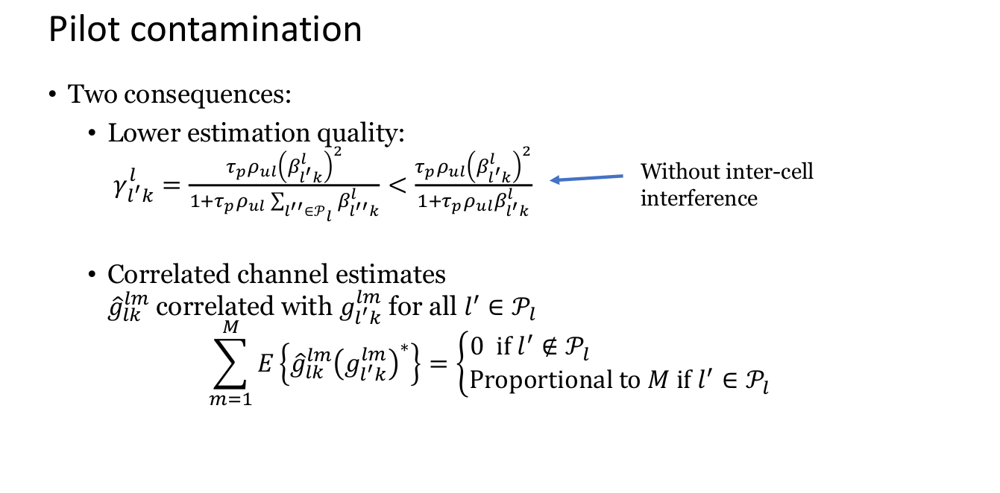

Slide 34
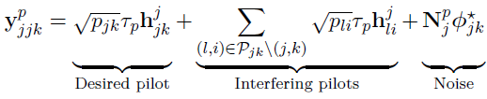
Channel estimation
Using the assumptions and the set
The expression above is simplified to

Slide 35
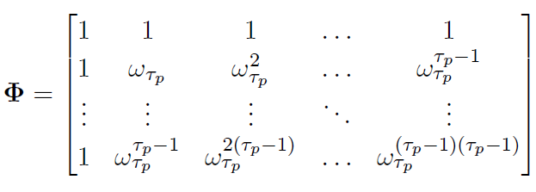

Design of Mutually Orthogonal Pilot sequences
Example: the discrete Fourier transform (DFT) matrix
All elements have unit magnitude and all columns are mutually orthogonal
where:

Slide 36

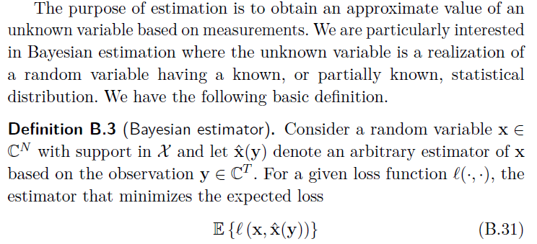
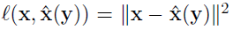
MMSE Channel Estimation
The channel is a realization of a random variable, thus Bayesian estimators are desirable since they take the statistical distributions of the variables into account. Bayesian estimators require that the distributions are known. Recall that

Slide 37








MMSE Channel Estimation
The minimum mean-squared error (MMSE) of is the vector that minimizes the mean square
error (MSE)
where
Pilot reuse may cause correlate the estimated channels
The estimation error has correlation matrix given by
MSE Error

Slide 38
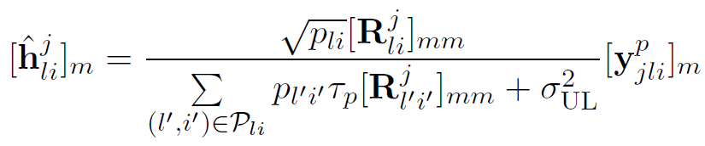
Element-wise MMSE Channel Estimator
This estimator utilizes only the diagonal elements of the matrix . Therefore, each element of channel vector is estimated separately and thereby ignore the correlation between the antenna elements of the BS
EW-MMSE estimation
EW-MMSE estimation
MMSE estimation

Slide 39
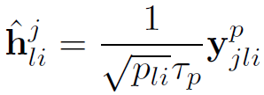



Least-square Channel Estimator
In case that the partial statistics of EW-MMSE are unknown or unreliable (e.g., due to rapid changes in the UE scheduling in other cells), it might be necessary to consider estimators that require no prior statistical information
LS-estimation
The LS estimate of is defined as the vector that minimizes the squared deviation

Slide 40
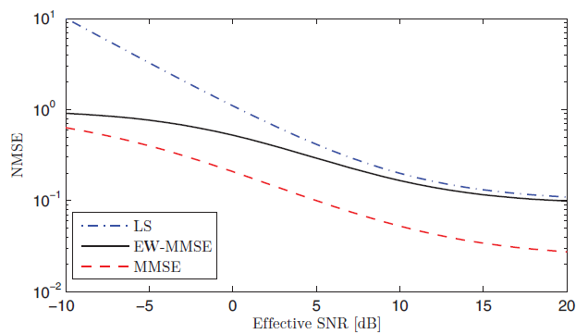
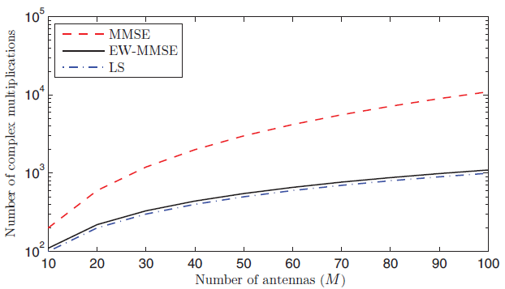
Estimator’s performance
NMMSE
Number of complex multiplications

